Slide 1
Annual General Membership Meeting
May 1st, 2021
2:00PM
Exhibition Hall C
Moncton Coliseum Complex

Slide 2
AGENDA
Call to Order
Reading of Notice of Meeting
Approval of the Meeting Agenda
Approval of Meeting Minutes from August 4th, 2020
Business Arising from Minutes of August 4th , 2020
Inscription of all members present
Correspondence
- Notice of Amendments
Reports of Officers
Reports of Committees
Unfinished Business
New Business
Nomination of Executive Members
Election of Executive Members
Nomination of Directors
Election of Directors
Election of Auditors
Adjournment

Slide 3
AGENDA
Call to Order
Reading of Notice of Meeting
Approval of the Meeting Agenda
Approval of Meeting Minutes from August 4th, 2020
Business Arising from Minutes of August 4th , 2020
Inscription of all members present
Correspondence
- Notice of Amendments
Reports of Officers
Reports of Committees
Unfinished Business
New Business
Nomination of Executive Members
Election of Executive Members
Nomination of Directors
Election of Directors
Election of Auditors
Adjournment

Slide 4
AGENDA
Call to Order
Reading of Notice of Meeting
Approval of the Meeting Agenda
Approval of Meeting Minutes from August 4th, 2020
Business Arising from Minutes of August 4th , 2020
Inscription of all members present
Correspondence
- Notice of Amendments
Reports of Officers
Reports of Committees
Unfinished Business
New Business
Nomination of Executive Members
Election of Executive Members
Nomination of Directors
Election of Directors
Election of Auditors
Adjournment

Slide 5
MMHA ANNUAL GENERAL MEETING
Moncton Minor Hockey Association will hold its Annual General Meeting on Saturday May 1st, 2021 at
2:00PM. This meeting will be held in Exhibition Hall C of the Moncton Coliseum Complex. Due to the ongoing
Covid-19 pandemic, pre-registration for this event is required and must be done at least 48 hours prior to the event. One registration form must be completed
per attendee.
Pre-registration must be done through the following link:
https://www.surveymonkey.com/r/GXPWTRB
If you are unable to register through this link, please contact Shaun Abbass at
executivedirector@monctonminorhockey.ca.
Election of officers will be held. You must be present at the meeting in order to be eligible to vote. All
GNB regulations in place at the time of this event will be followed. There always remains a possibility
that the Public Health Alert Level changes so that this event cannot take place, in which case a virtual
meeting may be coordinated.

Slide 6
MMHA ANNUAL GENERAL MEETING (cont)
Minutes from last year’s Annual General Meeting and the Agenda for this year’s meeting can be found on the association website at http://monctonminorhockey.ca/news.php?news_id=1922581. Anyone wishing to submit a Notice of Amendment to our Constitution and Bylaws document must do so prior to April 10th, 2021 by sending to the MMHA Secretary, Caryl McAteer, at secretary@monctonminorhockey.ca. All Notice of Amendments received will be posted to the MMHA website shortly after this submission deadline. All members in good standing are encouraged to attend.
MMHA 2021 Annual General Meeting Agenda Minutes of MMHA 2020 Annula General Meeting

Slide 7
AGENDA
Call to Order
Reading of Notice of Meeting
Approval of the Meeting Agenda
Approval of Meeting Minutes from August 4th, 2020
Business Arising from Minutes of August 4th , 2020
Inscription of all members present
Correspondence
- Notice of Amendments
Reports of Officers
Reports of Committees
Unfinished Business
New Business
Nomination of Executive Members
Election of Executive Members
Nomination of Directors
Election of Directors
Election of Auditors
Adjournment

Slide 8
AGENDA
Call to Order
Reading of Notice of Meeting
Approval of the Meeting Agenda
Approval of Meeting Minutes from August 4th, 2020
Business Arising from Minutes of August 4th , 2020
Inscription of all members present
Correspondences
- Notice of Amendments
Reports of Officers
Reports of Committees
Unfinished Business
New Business
Nomination of Executive Members
Election of Executive Members
Nomination of Directors
Election of Directors
Election of Auditors
Adjournment

Slide 9
AGENDA
Call to Order
Reading of Notice of Meeting
Approval of the Meeting Agenda
Approval of Meeting Minutes from August 4th, 2020
Business Arising from Minutes of August 4th , 2020
Inscription of all members present
Correspondence
- Notice of Amendments
Reports of Officers
Reports of Committees
Unfinished Business
New Business
Nomination of Executive Members
Election of Executive Members
Nomination of Directors
Election of Directors
Election of Auditors
Adjournment

Slide 11
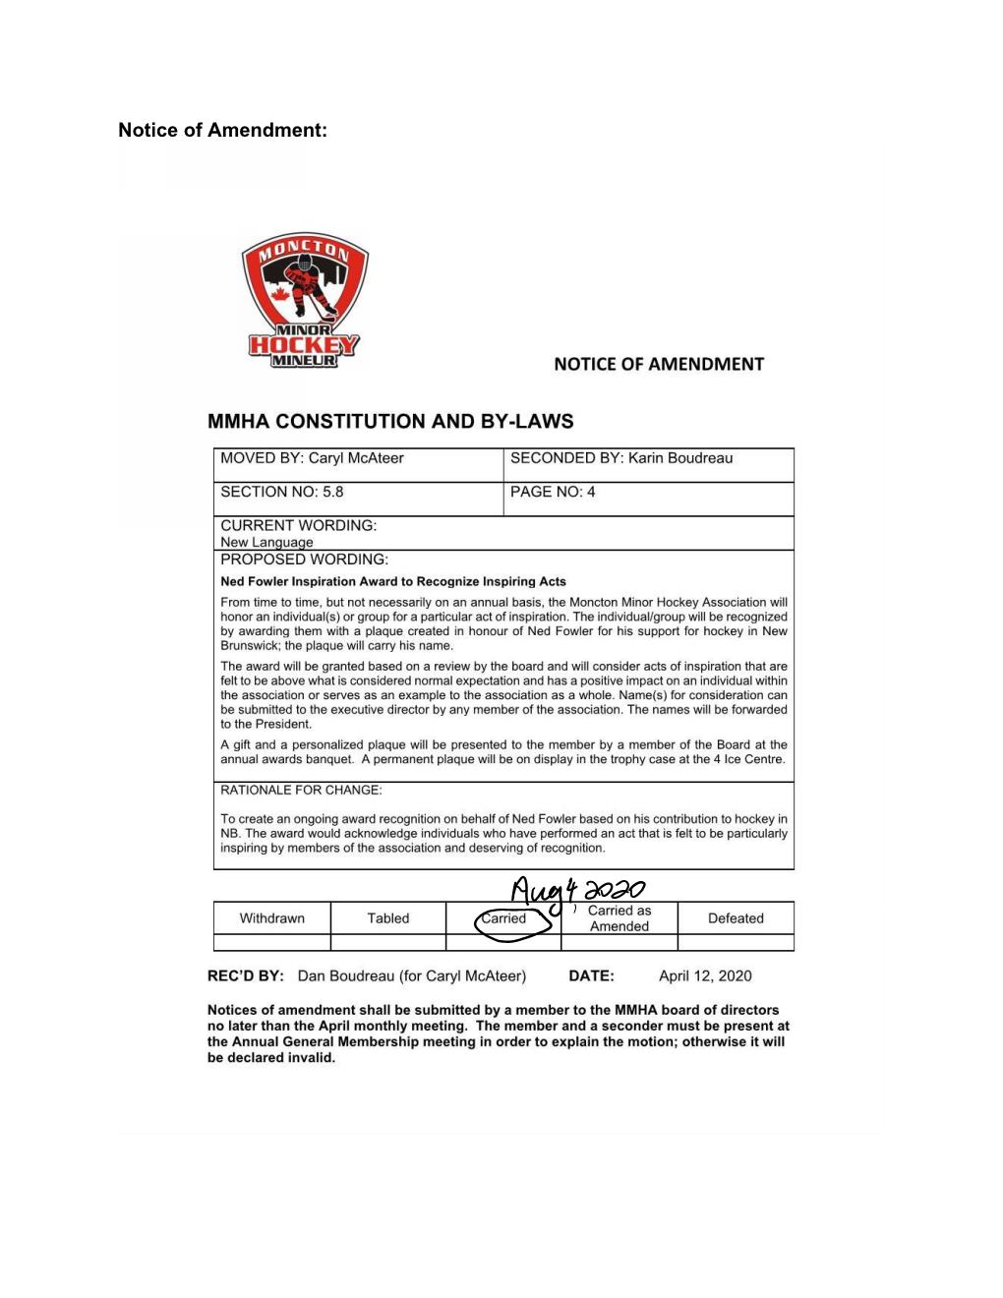

Slide 12
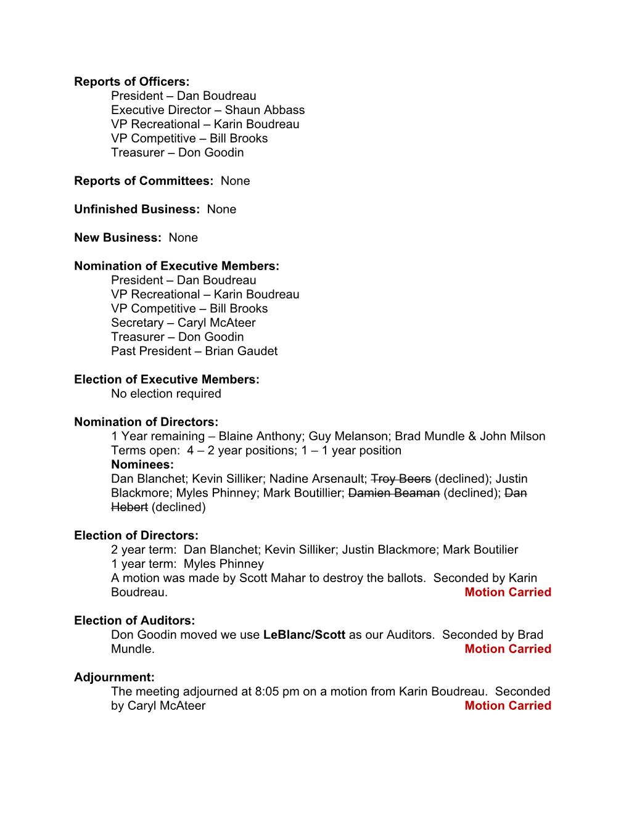

Slide 13
AGENDA
Call to Order
Reading of Notice of Meeting
Approval of the Meeting Agenda
Approval of Meeting Minutes from August 4th, 2020
Business Arising from Minutes of August 4th , 2020
Inscription of all members present
Correspondence
- Notice of Amendments
Reports of Officers
Reports of Committees
Unfinished Business
New Business
Nomination of Executive Members
Election of Executive Members
Nomination of Directors
Election of Directors
Election of Auditors
Adjournment

Slide 14
AGENDA
Call to Order
Reading of Notice of Meeting
Approval of the Meeting Agenda
Approval of Meeting Minutes from August 4th, 2020
Business Arising from Minutes of August 4th , 2020
Inscription of all members present
Correspondence
- Notice of Amendments
Reports of Officers
Reports of Committees
Unfinished Business
New Business
Nomination of Executive Members
Election of Executive Members
Nomination of Directors
Election of Directors
Election of Auditors
Adjournment

Slide 15
AGENDA
Call to Order
Reading of Notice of Meeting
Approval of the Meeting Agenda
Approval of Meeting Minutes from August 4th, 2020
Business Arising from Minutes of August 4th , 2020
Inscription of all members present
Correspondence
- Notice of Amendments
Reports of Officers
Reports of Committees
Unfinished Business
New Business
Nomination of Executive Members
Election of Executive Members
Nomination of Directors
Election of Directors
Election of Auditors
Adjournment

Slide 16
Correspondence
Jersey returns: For those who have not yet returned their jerseys, please contact John Milson to make arrangements. We know who you are and where you live!
Notice of Amendments to the Constitution and Bylaws:
Article 5.7 – Lifetime Membership
Article 5.8 – Ned Fowler Inspiration Award to Recognize Inspiring Acts
Article 7.4 – Executive and Board of Directors
Article 7.7 – Signing Officers
Article 7.8 – Board Meetings (Virtual Platform)
Article 7.15 – President
Bylaw G3 – Notice of Amendment Deadline
Bylaw G24 – Spending Limits (New)

Slide 17
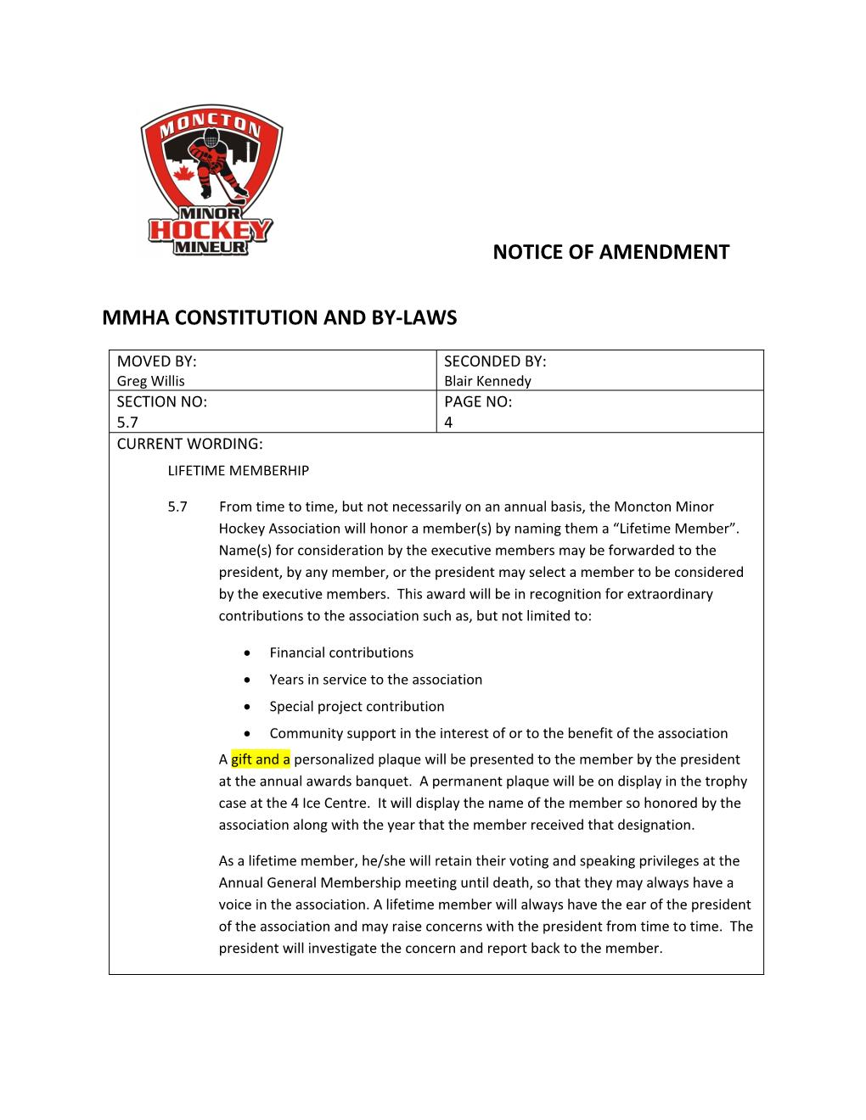

Slide 18
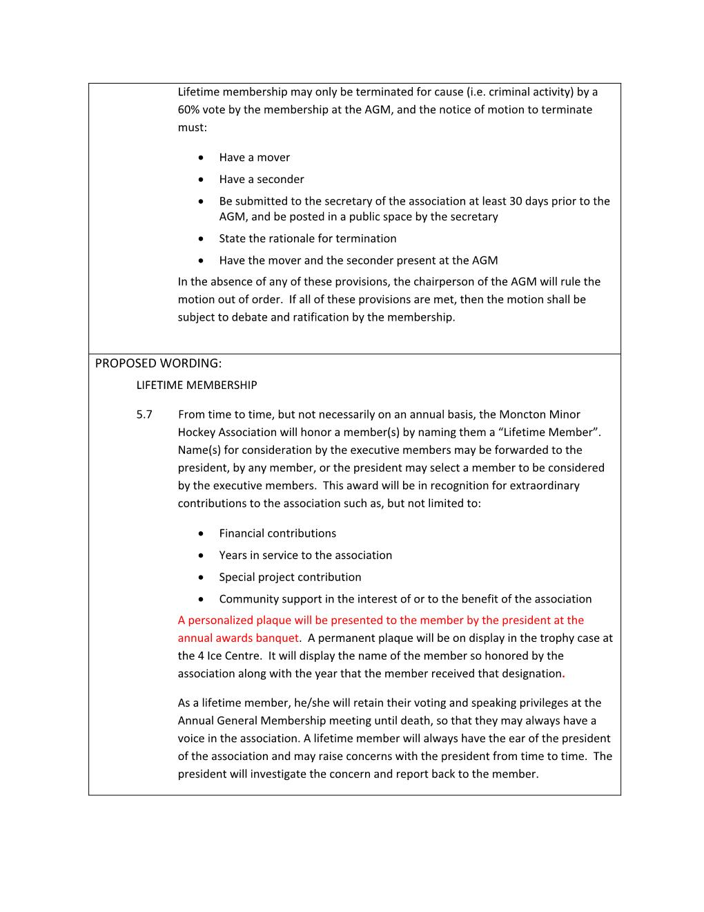

Slide 19
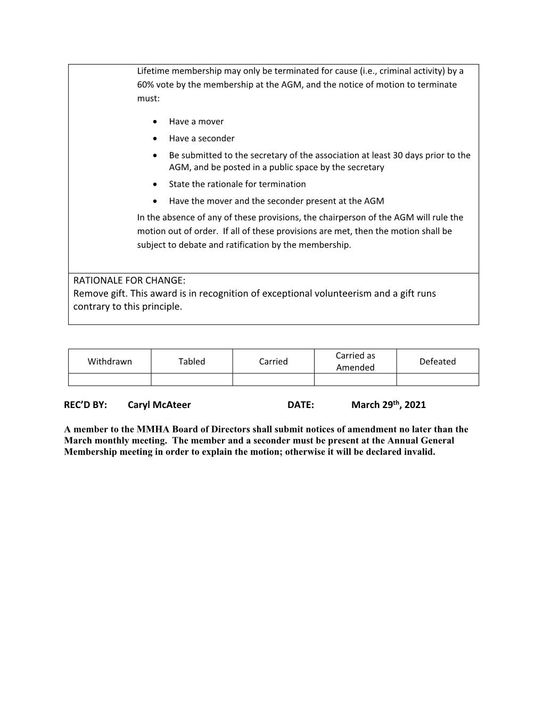

Slide 20
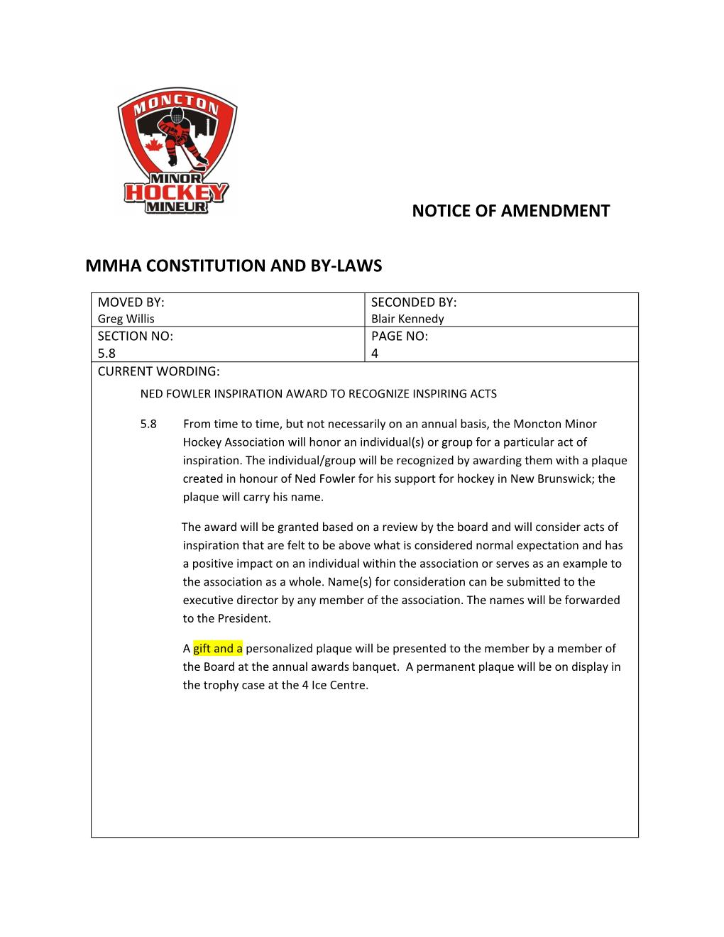

Slide 21
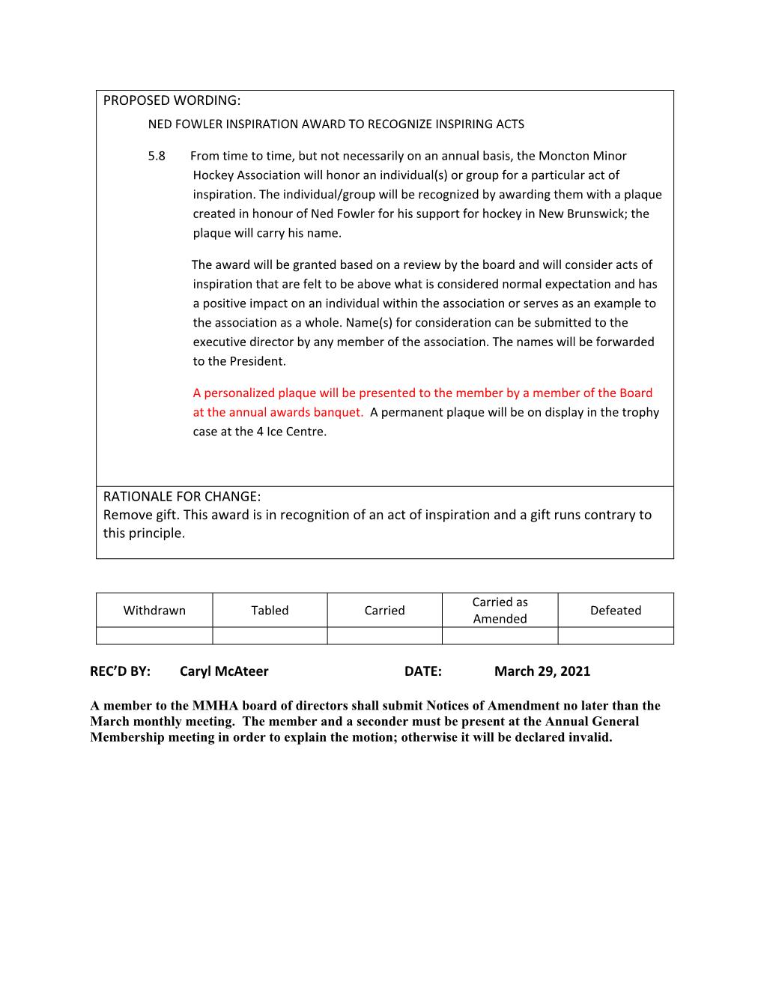

Slide 22
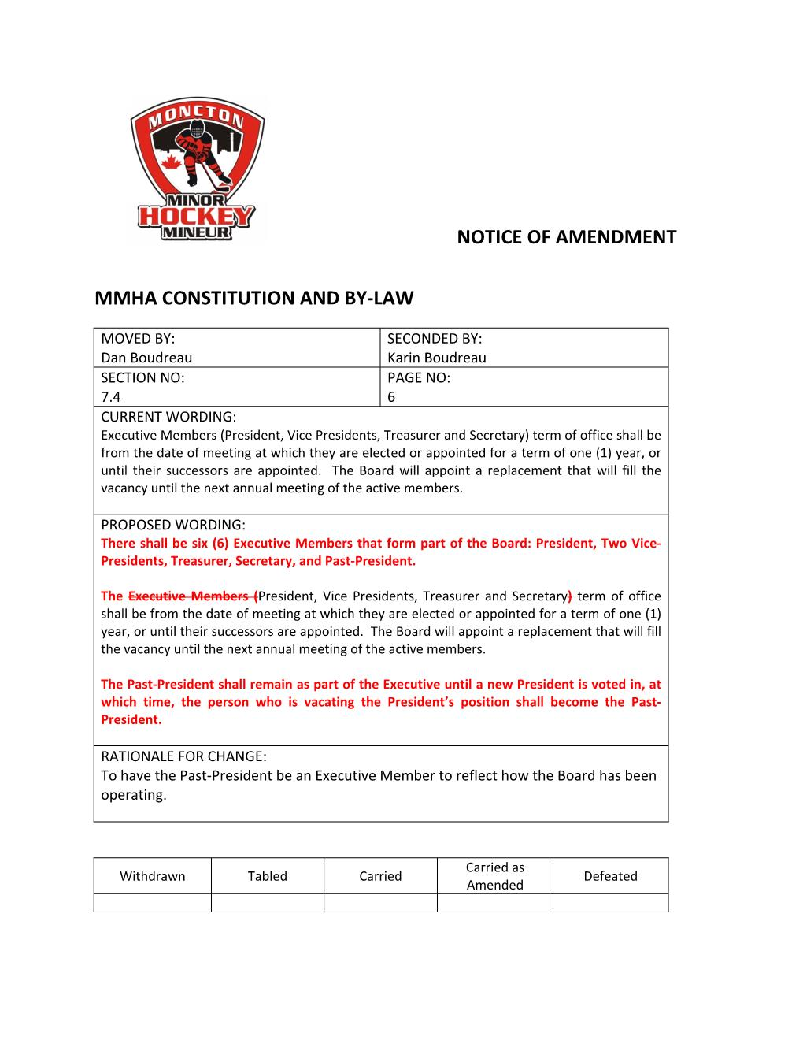

Slide 23
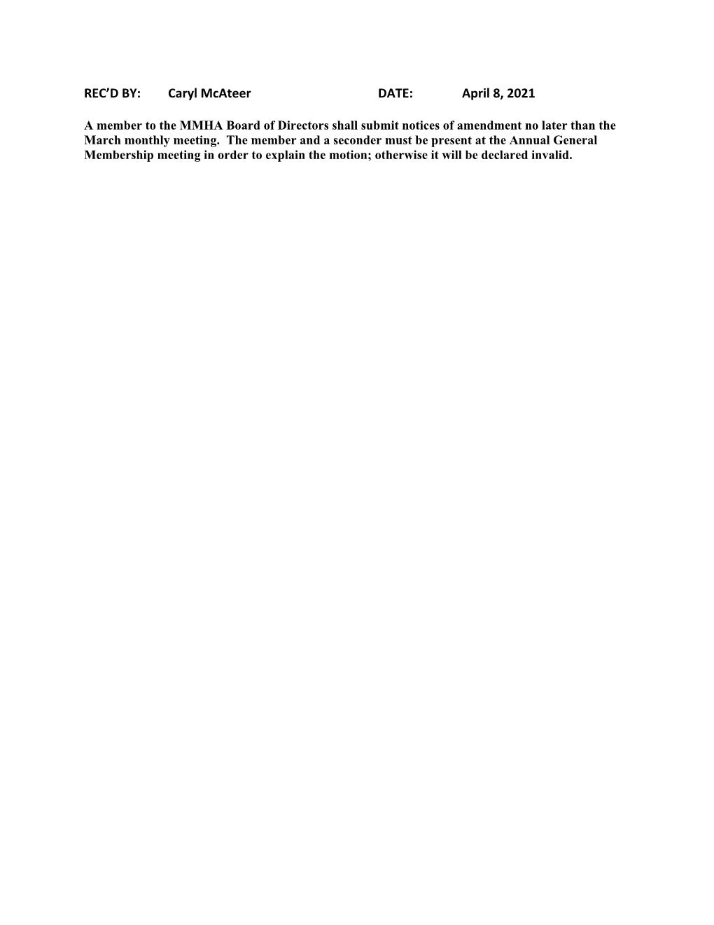

Slide 24
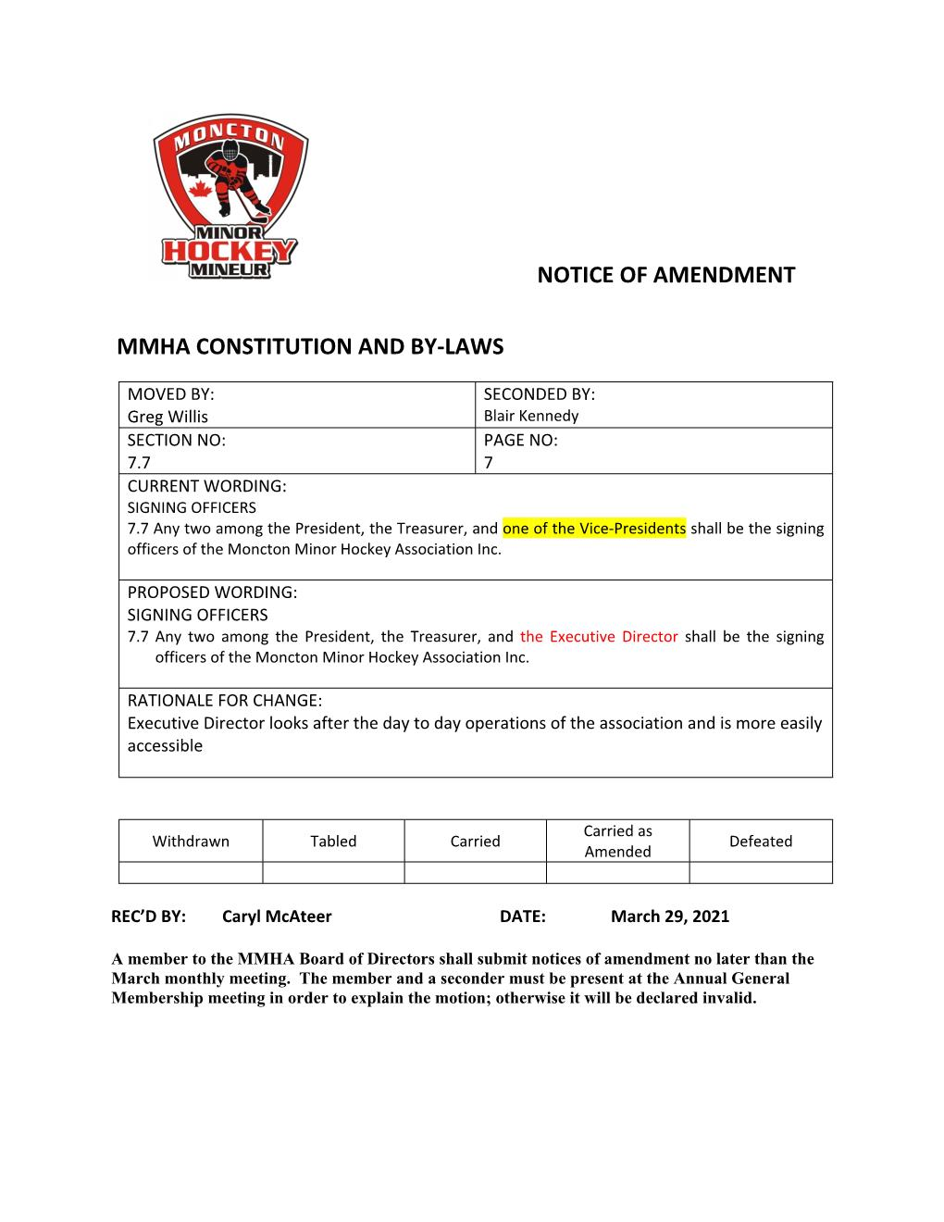

Slide 25
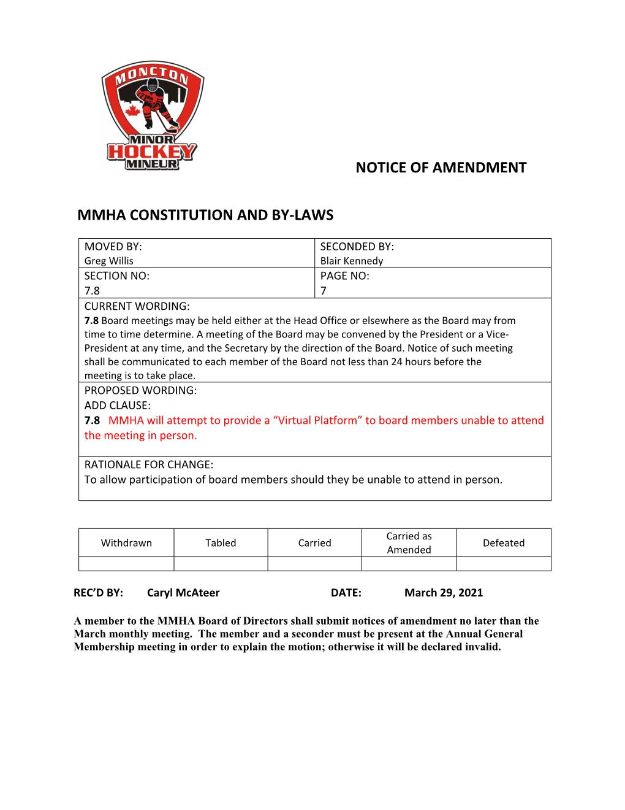

Slide 26
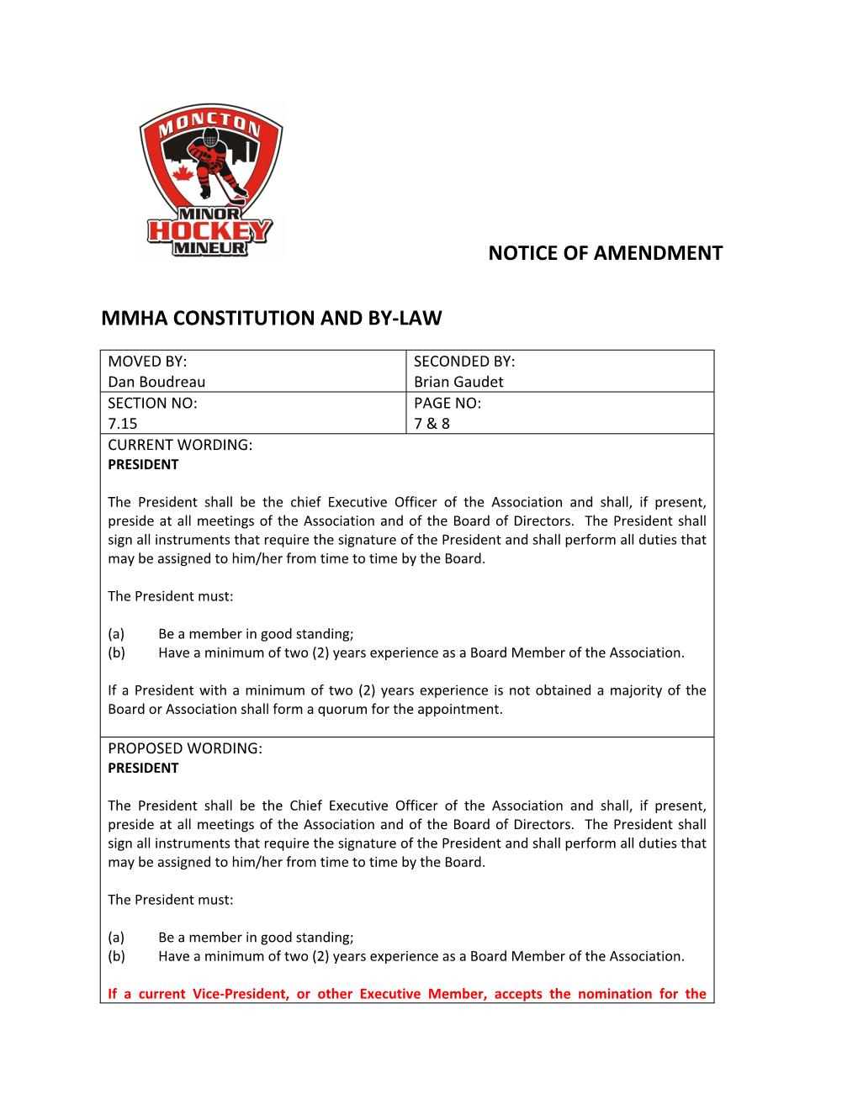

Slide 27
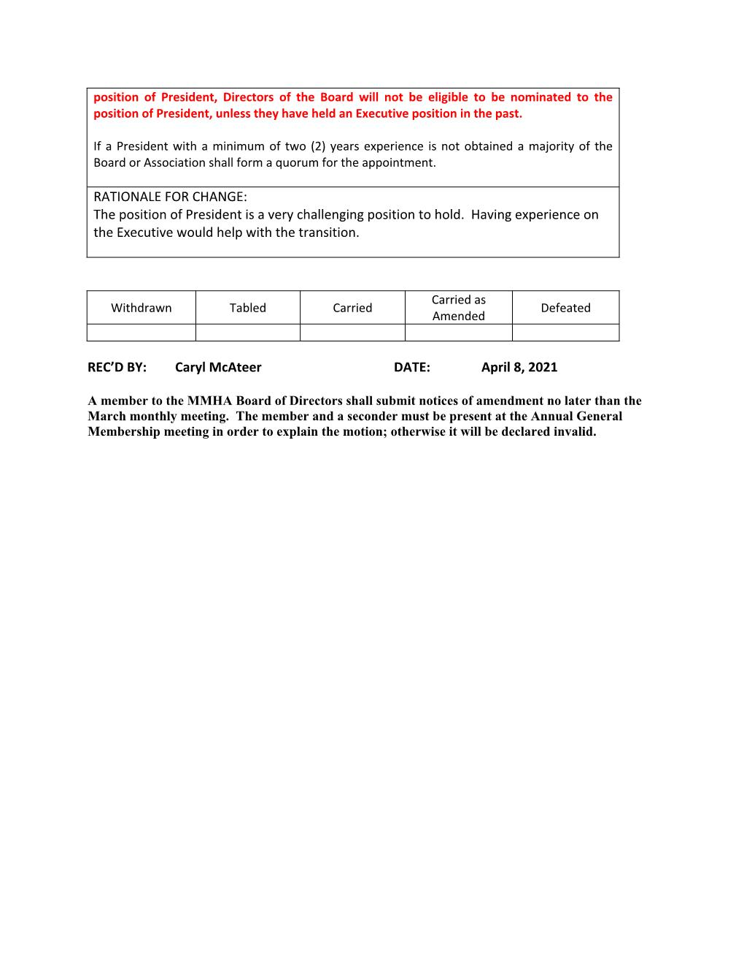

Slide 28
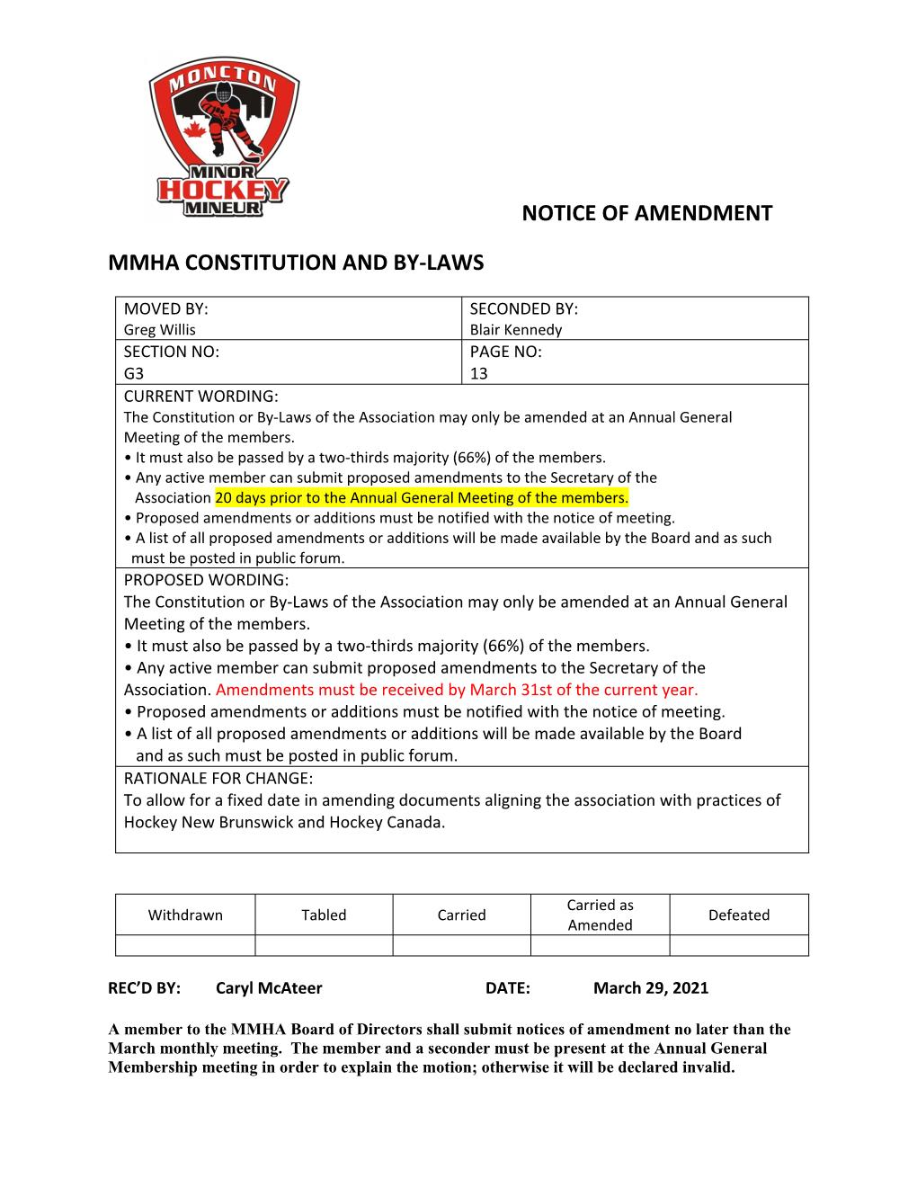

Slide 29
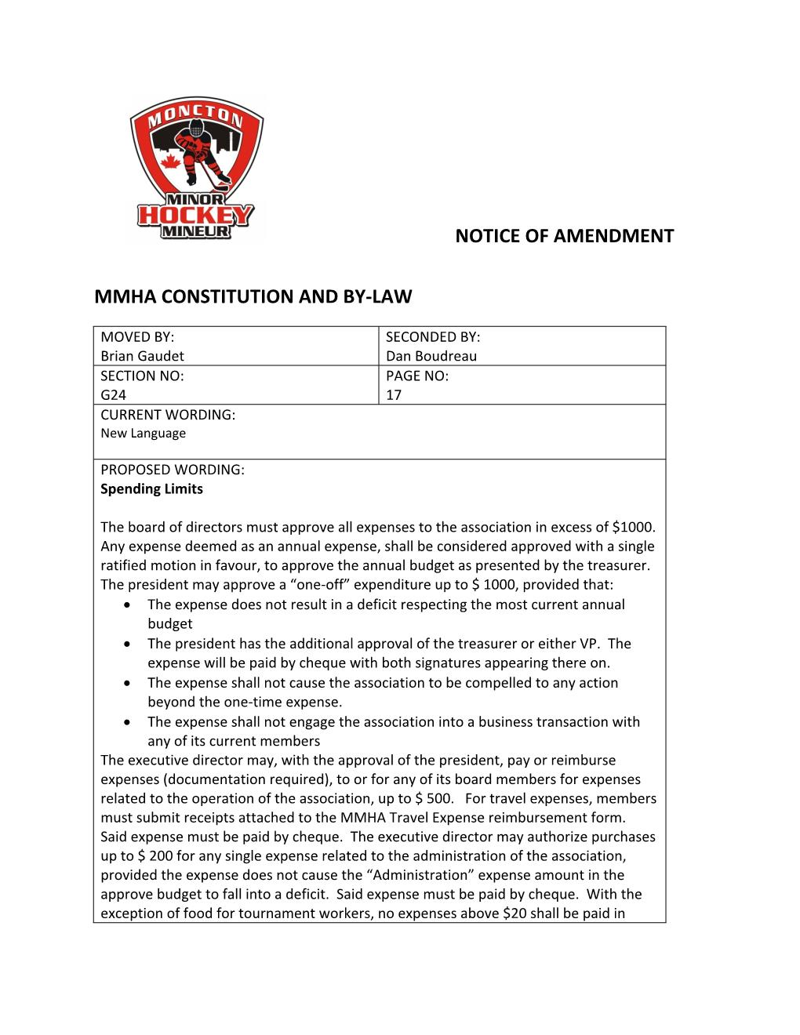

Slide 30
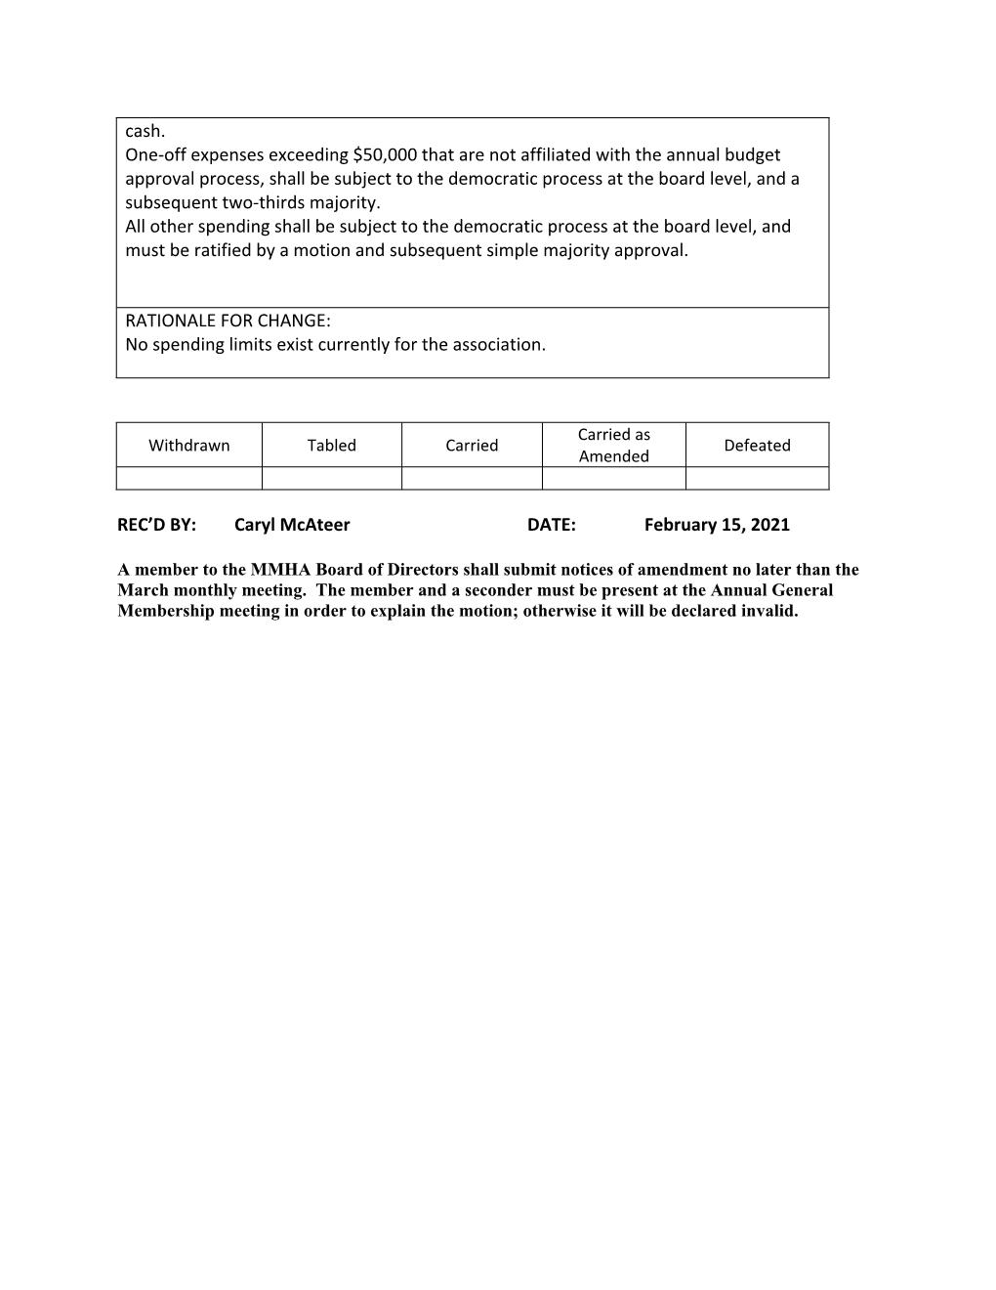

Slide 31
AGENDA
Call to Order
Reading of Notice of Meeting
Approval of the Meeting Agenda
Approval of Meeting Minutes from August 4th, 2020
Business Arising from Minutes of August 4th , 2020
Inscription of all members present
Correspondence
- Notice of Amendments
Reports of Officers
Reports of Committees
Unfinished Business
New Business
Nomination of Executive Members
Election of Executive Members
Nomination of Directors
Election of Directors
Election of Auditors
Adjournment

Slide 32
Reports of Officers
President’s Report
Executive Director’s Report
VP Competitive Report
VP Recreational Report
Treasurer’s Report

Slide 33
President’s Report 2020-2021
The 2020-2021 season will certainly be one that we all remember. This is not quite how we envisioned our 50th Anniversary Season playing out, but we were able to have a hockey season, and get the kids out onto the ice, unlike many associations across the country, so we should all be thankful for that.
With this being my sixth season on the MMHA Board, and third year as President, this year has been a challenge long before it even began. With the three-and-a-half month delay before last year’s Annual General Meeting, where we elected our new Executive and Board, we did not have the luxury of time to plan the season through a series of meetings held throughout the summer, as we typically would.
While some of us tried to plan throughout the summer as best we could, nothing could be finalized until after our new Executive and Board were elected on August 4th, 2020.

Slide 34
Our team of volunteers did the best that we could with the information that we had at the time, when key decisions had to be made. As many are aware, the recommendations and restrictions due to the ongoing Covid-19 Pandemic were constantly changing throughout the season, and this further complicated the decisions that had to be made, and how we had to continue on through these changes.
No tournaments; no Provincials; no Volunteer Appreciation Banquet; not being able to properly celebrate our 50th Anniversary Season.
But as difficult as this season has been, there were many positive things that happened throughout the season, so we will try to focus more on those.
…and we were able to close out the season with four weeks of games, concluding with our Day of Champions…something we were unable to do last season.

Slide 35
Following my report, our Executive Director, our two Vice-Presidents, and our Treasurer will speak about the number of players, teams, and games that the association supported throughout the season, as well as the state of our finances, so I will not get too deep into the specifics of these items…but I will, no doubt, steal a bit of their thunder.
It’s important to remember, as you listen to the specifics of the past season, that none of this happens without our volunteers, and they deserve our appreciation, thanks, and respect.
CONGRATULATIONS
TO ALL AWARD WINNERS
AND
THANK YOU!!!
TO ALL OF OUR DEDICATED VOLUNTEERS!!!!

Slide 36
This past season, Moncton Minor Hockey had the privilege/challenge of administering a minor sports program for 635 players. While it is always challenging to satisfy all players; potentially 1,270 parents; and 246 volunteers, especially this season, it is a very rewarding experience, and the rewards far outweigh the challenges.
We always do our best to make decisions that are in the best interest of all of our players, as well as our association, but these decisions do not always satisfy everyone, especially this season, and that makes some of these decisions all the more difficult.
We are hopeful that, as we keep learning to live with this pandemic, and with vaccines continuing to roll out, next season will run much smoother. While we are sure that there will still be restrictions in place, at least to start next season, we are confident that with the lessons learned from this past season, that the experience will be much better for all members.

Slide 37
Moncton Minor Hockey is very fortunate to be supported by a number of community partners. I would like to acknowledge and thank:
The City of Moncton
The Province of New Brunswick
The Moncton Wildcats
Easter Seals of New Brunswick
The Advance Savings Credit Union
The Lounsbury Group
Doyle Corporate Image
Doc Martin Braces
Canadian Tire/Jumpstart
The Corey Craig Group (Tim Horton’s Ltd)
McDonalds Restaurants
Papa John’s Pizza
DP Murphy Group of Hotels
Without their generosity, your children would not enjoy the quality program that MMHA is currently able to provide.

Slide 38
As challenging a season as this past season was, there were still lots of positives that we were able to achieve. But first, the challenges:
Our registration numbers dropped slightly, from 639 players to 635 players (514 recreational players and 121 competitive players). Considering the fact that we were administering a minor sports program through a global pandemic, this decrease in registration numbers was not unexpected. But this still brings us to a total reduction of 66 players over the past three seasons. The main reasons for this drop for the current season are as follows:
Covid-19 concerns (U7 (2015 birth years) numbers down; U11 and U13 numbers down)
A new U16 AAA (U18 Minor) EDZA team this season
Successful high school team tryouts, both male and female players, caused a significant decrease in our U18 Division
23 of the 34 roster spots on the two regional EDZA U13 AAA teams were earned by MMHA players

Slide 39
To help increase our registration numbers, I personally reached out to all players who played with us over the past two years, to advise that registration was open. I did this multiple times from the time that registration opened, until the end of September. For those who decided not to register, I enquired as to why they decided not to play.
Our registration numbers would have been much worse had we not had a U21 Division this season, which provided a place for 36 players to play.
The number of goaltenders at the younger Divisions appear to be on the decline, so we looked at ways to improve this situation. Several more sets of goaltending gear was purchased, and the U7 and U9 age groups were encouraged to dress multiple goaltenders during each practice to generate more interest. This appears to have worked, with four to six players moving up to the U11 Division next season who want to be goaltenders. Moving forward, this, and other options, will continue to be considered.

Slide 40
Our declining U11 numbers, as well as the declining number of goaltenders at the U11 age group, forced us to go with only two U11 competitive teams, instead of three, for the first time in many years.
The roller coaster season, with constant changes, was by far the biggest challenge that we faced.
October 1st to 8th, 2020: Covid Yellow (8 days)
October 9th to 22nd, 2020: Covid Orange – Shut Down (14 days)
October 23rd to November 19th, 2020: Covid Yellow (28 days)
November 20th to December 6th, 2020: Covid Orange – Practice Only (17 days)
December 7th, 2020 to January 5th, 2021: Covid Yellow (30 days)
January 6th to 19th, 2021: Covid Orange – Practice Only (14 days)
January 20th to February 8th, 2021: Covid Red – Shut Down (20 days)
February 9th to March 7th, 2021: Covid Orange – Practice Only (27 days)
March 8th to April 4th, 2021: Covid Yellow (28 days)

Slide 41
The cancellation of all tournaments and jamborees for the season was a huge challenge financially, as our tournaments typically add over $30,000 worth of revenue to our association. More importantly, it took away from the full hockey experience for our players, as going away for tournaments is what most look forward to each season so they can bond together as a team, and form friendships and experiences outside out hockey.
The cancellation of Provincials for the second consecutive season was a huge disappointment, as well.
The cancellation of our annual Volunteer Appreciation Banquet for the second consecutive year was a huge disappointment for our association.
While MMHA was selected to be a host for the Bauer First Shift program this past season, the Board decided that, due to all of the unknowns associated with the Covid-19 pandemic, hosting this program for the 2020-2021 season would not be in the best interest of the association, so we declined.

Slide 42
Our Discipline Committee had a very challenging season, with formal complaints received for eight separate incidents that needed to be investigated. With only two of these incidents taking place prior to the early March transition back to the Covid Yellow Phase, the last four plus weeks of the season certainly made up for it. The committee had to convene six Disciplinary Hearings over the final seven days of the season.
The ongoing Abuse of Officials from some teams prompted MMHA to deliver a message to all of our teams’ staff members to remind them that this behaviour will not be tolerated, and those who continue to do this would run the risk of no longer having on-ice officials provided for their scheduled games. While most teams were being respectful of our officials, this message had to be sent out to everyone. I am happy to report that this measure appears to have worked, as there was only one incident once this message was sent out. It is sad that we had to tell adults that this behaviour is not okay; yelling at some of our 13, 14, and 15 year old new officials and having them leave the rink in tears is not okay.

Slide 43
There will be no refunds or credits provided for registration fees, as we ended up finishing the season with a slight deficit. The main reason for his was because we did not increase registration fees. While we did lose 34 days this season due to two Covid-19 shutdowns (October 9th to 22nd, 2020 and January 20th to February 8th, 2021), bear in mind the following:
Three of those days were during Thanksgiving weekend where we had no icetime scheduled anyway.
The season was extended by three weeks to April 4th, 2021.
Additional daytime icetimes were added on Family Day, March Break, and Good Friday.
No weekend icetimes were lost to tournaments (typically five weekends in a typical season, after the Thanksgiving weekend).
Year | Total Hours of Ice | Hours of Ice Lost To Tournaments | Total Hours of Ice for MMHA Teams
2019/20 | 1,674 | 285 | 1,389
2020/21 | 1,532 | 0 | 1,532

Slide 44
But the season was not all “Doom-and-Gloom” and we were able to find some positives to build on, as best we could. Our association also worked on a number of key objectives along the way.
We were able to hold the line on our registration fees, and keep them the same as last season, even though some of our neighboring associations introduced large fee increases. We figured that implementing a registration fee increase, in the midst of a global pandemic, may not be the best way to attract new members or to retain current members. The fact that some families may be struggling financially due to the Covid-19 pandemic also played a role in this decision.
The Competitive Team and Competitive Coach Selection Processes that have been implemented over the past several seasons continue to be modified as areas of improvement become apparent. At our April Board of Directors Meeting, we ratified nine Notices of Amendment to our Operations Manual. Our updated Operations Manual can be found on our website.

Slide 45
We celebrated our 50th Anniversary Season as best we could, with two teams randomly selected to receive customized 50th Anniversary jerseys to use for the season, and to keep at the end of the season. While we didn’t get to see the jerseys as much as we would have hoped, they did receive some great reviews. We also had some merchandise for sale throughout the season, with some products still available. Our 50th Anniversary Planning Committee will remain in place for next season so we can extend the celebration, and hopefully host some of the events that we had originally planned.
We created a U21 Division (formerly Juvenile) for the first time in almost ten years. We had enough interest to create two teams, both of which played in a league with two teams from Hockey Dieppe-Memramcook. We already have interest in this division for next season, and we are optimistic about this moving forward.
Conditioning Camps, that are required under the U11 Player Pathway, were offered for all divisions. We will look to do this again next season.

Slide 46
Our weekly progressive 50-50 draw, which will continue throughout the summer, provided MMHA with a total profit of $1,386 as of March 15th. All proceeds will go directly towards the association to help offset our costs and keep registration fees down. The best part of this program is that it requires no volunteers to help administer, aside from a bit of advertising.
Our Safety Committee continues to work closely with the Superior Propane Centre to ensure that the facility is maintained to the standard that is acceptable to our membership and our visiting teams.
We have established a Strategic Planning Committee, and have developed a draft Strategic Plan, with more information coming up on this later under Committee Reports.
We have established a Documents Review Committee consisting of many of our longtime volunteers, to review our Constitution and Bylaws document, as well as our Operations Manual, and to provide recommendations to our Board for consideration.

Slide 47
We have once again applied to host the Bauer First Shift program for the upcoming season. We again hope that this will translate into several new members to our program for the upcoming season. In the past, the First Shift program has been a true benefit in our efforts to grow our membership. This past season, only 6 of the 20 participants from the previous season’s First Shift program registered with MMHA, however, we suspect that most of the others did not register due to Covid-19 concerns.
After having set up a Facebook Page for our association last summer, we used that, along with our website and email communications to try and keep all of our members informed and up to date in regards to what was happening within the association. It has been a constant challenge trying to find the most effective way to get information out to our members, however, not everyone is on Facebook; not everyone constantly monitors our website or their email accounts; and some of our emails land in some people’s email spam folders.

Slide 48
We have recently purchased a subscription to Team Snap, which we plan to use as another way to communicate with our membership.
Late this season, we sent out a survey to all team staff to obtain feedback from the services that MMHA currently provides, in order to see where we could improve. Most of the feedback was positive, which was greatly appreciated. Generally, the ratings that were received ranked from good to very good, but there was definitely room for improvement in several areas. Several key comments were received, and they will all be considered. The most common issue brought up, by far, was for us to provide longer term schedules, and this will be addressed. If anyone who provided comments would like to discuss anything further, please feel free to contact us. In order for us to be able to implement these suggestions, we will need volunteers. Please consider being nominated to a Board of Directors position for next season to help make this happen!

Slide 49
The MMHA Board continues to be dedicated to accessibility to hockey through our Sledge Hockey program. Thank you to our Sledge Hockey Coordinator, Brad Mundle, and his dedicated group of volunteers for making this happen.
As with all programs this was a challenging year, however, with the assistance of Easter Seals New Brunswick, we were able to provide one ice-time per week at the SPC during the Covid Yellow Phases. Participant numbers were understandably down, however, we maintained a dedicated group of approximately 15 enthusiastic players throughout the season.
This year we were able to purchase some new special blades for our goalies, some increased back support for some of our sledges, and some anti tip devices for use by new players.
Like all MMHA programs, we were lucky to have a group of dedicated volunteers that are committed to the participants’ safety, welfare, and fun. If anyone would like to participate or volunteer, do not hesitate to contact Brad Mundle for more information.

Slide 50
Continuing on with the topic of accessibility to hockey for as many people as possible, we had the pleasure of discussing the concept of Blind Hockey with local hockey enthusiast Simon Richard. It is an interesting concept, and one that we will look into trying out next season.
I’d like to thank all of our coaches, managers, Covid liaisons, and to all those who have contributed in any capacity to the association.
Thank you to long time volunteers Greg Willis, Blair Kennedy, Moe Leger, Bob Hachey, Scott Mahar, and Troy Denton for all of your ongoing contributions.
Thank you to Alex Estabrooks, your referee assignor, who had the daunting task of scheduling almost an entire season’s worth of on-ice officials during the last four weeks of the season.
Thank you to Shaun Abbass, our Executive Director, for continuing to take care of the day-to-day business of MMHA.

Slide 51
I’d like to thank my fellow Members of the Board, for all the work that you do, throughout the season, to make our association as successful as it is. A special thank you to our current Board and Executive Members who will not be reoffering for the upcoming season. You will all be greatly missed: Blaine Anthony; Karin Boudreau; Mark Boutilier; and Guy Melanson.
Thank you everyone, and stay safe!!!
Dan Boudreau
MMHA President 2020-2021
Questions?

Slide 52
MMHA Executive Director’s Report 2020-2021
My third year as Executive Director was a busy one. The ED’s job has still relies heavily on help from people like Greg Willis, Blair Kennedy, Moe Leger, Bob Hachey and Scott Mahar. This season I also received a great deal of help with ice scheduling from Bill Brooks and Dan Boudreau. Direction from the board has been clear and well thought out. I am looking forward to continuing my work with Moncton Minor Hockey.
Registrations
Total registrations
Division | M | F | Total | # of Teams
Under-7 (U7) | 89 | 1 | 90 | 7
Under-9 (U9) | 100 | 3 | 103 | 7
Under-11 (U11) | 110 | 4 | 114 | 8
Under-13 (U13) | 93 | 7 | 100 | 7
Under-15 (U15) | 118 | 8 | 126 | 8
Under-18 (U18) | 75 | 0 | 75 | 4
Under-21 (U21) | 35 | 2 | 37 | 2
Total | 620 | 25 | 645 | 43

Slide 53
Volunteers
Covid-19
The Covid season we just completed was an exercise in frustration to say the least:
Changing protocols, sometimes by the week.
Contact tracing documents.
Limitation on the number of people allowed at the rink.
Schedules and contact lists had to be coordinated with SPC 4 Plex.
Updated protocols had to be communicated to our membership.
We have learned a lot and moving forward with Covid should be improved.

Slide 54
Ice Usage
Total # of ice times = 1,532
Tournaments
None.
Shaun Abbass
MMHA Executive Director 2020-2021

Slide 55
VP Competitive Report 2020-2021
I would like to start by thanking the many volunteers (coaches, assistant coaches, managers, Covid Liaisons, helpers and parents) for their commitment to our players and our association. There is a lot of time and effort required at many levels to give our players a rewarding hockey experience. This would not be possible without you.
Our competitive hockey program this season consisted of 7 competitive teams…. 2 Atom teams (AA, A), 2 Peewee Teams (AA and A), 2 Bantam Teams (AA and A) and 1 Midget Team (A). We had one less Atom team last year vs the previous year based on registrations and the number of goaltenders in that division. We had 216 players tryout for a competitive team which was a decrease of 2% over the previous year. There were four new head coaches in the competitive group of the seven teams.

Slide 56
Overall, I believe we had a successful, albeit challenging season under the changing covid phases and guidelines. We must count ourselves as fortunate to have had the season that we did, as there were many areas of the country that did not have a season at all. MMHA appreciates the extra effort required by coaches and team managers to keep the players engaged during those periods when games were not allowed. Players continued to develop and grow which in the end is the objective.
With a large association, there will be challenges and opportunities for improvement. I believe we are headed in the right direction. With the way this season unfolded, we offered development sessions for all age groups which was a large undertaking from a scheduling and communication standpoint. This helped us identify key areas to work on to improve our processes. We will continue to evolve and improve to provide our players and families with the best hockey experience possible.

Slide 57
I would like to thank our Technical Director Blaine Anthony for his contributions and guidance this past season. And finally, thank you to my fellow board members for their support and hard work.
Regards,
Bill Brooks
MMHA VP Competitive Hockey 2020-2021

Slide 58
VP Recreational Report 2020-2021
Good afternoon. My name is Karin Boudreau. This is my fifth year on the Board of Directors, and my second as the VP of Recreational hockey. This past season, we had 36 recreational teams participating in our association.
U7(1) – 3 teams
U7(2) – 4 teams
U9(1) – 4 teams
U9(2) – 3 teams
U11 – 6 teams
U13 – 5 teams
U15 – 6 teams
U18 – 3 teams
U21 – 2 teams
2020-2021 has certainly been the most difficult season I have ever seen, however, despite the challenges, we did manage to get a hockey season in the books. This is a fact that should be seen as a huge success, since many other places in Canada did not. With the constant changes in the rules as the COVID phases were adapted, we all learned to be flexible. This is a skill that will serve our kids well into the future.

Slide 59
Unfortunately, due to the ongoing Pandemic, and with Public Health cancelling all Tournaments and Jamborees for the season, we were unable to host our annual Lounsbury’s Recreational Tournament or Doyle’s Novice Jamboree…two events that we look forward to each and every season.
On our Day of Champions, I had the opportunity to watch many games at various age levels. There was a lot of very close competition! The grins on the faces said it all! All of the hoops we had to jump through all season long were well worth it! The results from the Day of Champions were as follows:
U11 Gold: Team LeBlanc-Tingley
U11 Silver: Team Harquail
U11 Bronze: Team Cripps
U13 Gold: Team Clements
U13 Silver: Team Melanson
U13 Bronze: Team Poitras
U15 Gold: Team Steeves
U15 Silver: Team Reitzel
U18 Gold: Team Milson
U18 Silver: Team Murray

Slide 60
We also had two teams compete in a U21 league that was operated by Hockey Dieppe-Memramcook.
Our many volunteers help MMHA meet our primary objective: a place for kids to have fun, make friends and develop life skills through playing hockey. I would like to thank our coaches, managers, Covid Liaisons, officials, and rink staff for helping us achieve our goals. I want to thank my fellow Board Members for graciously donating their time to make MMHA a great association for our children. I want to especially thank the MMHA coordinators (Dan Blanchet, Justin Blackmore, Guy Melanson, Kevin Silliker, Mark Boutilier, and Myles Phinney) for your significant contributions, behind the scenes, making MMHA the city’s best minor hockey association.
At the end of this 50th Anniversary season that none of us will ever forget, remember this:
Our kids were able to get on the ice, practice, play games, and interact with their peers. For these reasons, 2020-2021 was a success!
Karin Boudreau
MMHA VP Recreational Hockey 2020-2021

Slide 61
Treasurer’s Report 2020-2021
Building a budget back in August 2020 was a nightmare for Dan, Shaun, and I. With all the changes and assumptions that were made in regards to the Phases of Hockey New Brunswick’s Return to Hockey Guidelines
Only one rink to be available for the season; then 2; maybe 3; and then eventually all 4.
Maximum team sizes of only 12 players; then 15 players; then 18 players.
Less ice.
Tournaments or no tournaments?
With no tournaments; no tournament revenue.
With no tournaments; more ice time to distribute amongst our teams, which would lead to additional costs for ice rentals.
I think we ended with Version 14 of the budget as our final version, so yes there were a lot of increases and decreases when comparing our actual costs and revenues to those budgeted.

Slide 62
We all know this was a challenging season (COVID Orange, Yellow, and Red) versus what we expected back In August 2020.
A quick summary of our Actual vs. Budgeted Revenue and Expenses, as mentioned, there were lots increases and decreases with a COVID filled year. We had originally appeared to be in a surplus position, where we could offer refunds to our membership, however, once we finalized the financials for the season, we actually finished the season with an $18,597 deficit, so refunds were not a possibility.
There were several factors that put us into a deficit position:
Decrease in overall Registration Fees
Decrease in Ice Cost Recoveries from Competitive Teams while in the Covid Orange Phase
Decrease in Competitive Player Levies due to only 7 Competitive Teams this season, where 8 were budgeted for
No revenue from tournaments ($35,861 in 2019-2020)
No lost icetime due to tournaments…typically five weekends per season (icetime costs for Friday through Sunday amounts to $14,154)

Slide 63
 | Actual | Budget |  | Delta
REVENUE | 2021 | 2021 |  | Actual - Budget
Grant - City of Moncton | $189,368 | $187,035 |  | $2,333
Registration fees | $303,130 | $312,920 |  | -$9,790
Ice cost recoveries | $33,871 | $48,000 |  | -$14,129
Tournaments | $0 | $900 |  | -$900
Competitive player levy | $30,250 | $38,250 |  | -$8,000
Competitive tryouts | $14,009 | $16,470 |  | -$2,461
Sponsorship | $11,749 | $2,500 |  | $9,249
50 Years and Re-Assign 2019-2020 Profit (Covid) | $45,000 | $45,000 |  | $0
Other revenue | $13,655 | $6,000 |  | $7,655
TOTAL REVENUE | $641,032 | $657,075 |  | -$16,043
EXPENSES
NBAHA Registration | $44,523 | $53,000 |  | -$8,477
League Registrations | $1,350 | $1,500 |  | -$150
Ice costs | $469,621 | $479,446 |  | -$9,825
Uniforms and equipment | $9,044 | $6,000 |  | $3,044
Coaches banquet | $2,508 | $1,000 |  | $1,508
Development expenses | $1,696 | $6,000 |  | -$4,304
Referees | $32,239 | $26,830 |  | $5,409
Referee assignor | $6,000 | $7,000 |  | -$1,000
Sponsorship - Development program (AAA) | $6,800 | $6,000 |  | $800
Executive Director | $42,480 | $42,000 |  | $480
Day of Champions expense | $3,220 | $2,000 |  | $1,220
50Th Year | $13,324 | $10,000 |  | $3,324
Adminstative Expense | $26,824 | $16,300 |  | $10,524
TOTAL EXPENSES | $659,629 | $657,075 |  | $2,554
EXCESS (DEFICIENCY) | -$18,597 | $0 |  | -$18,597

Slide 65
Don Goodin, CPA/CGA
MMHA Treasurer 2020-2021

Slide 66
AGENDA
Call to Order
Reading of Notice of Meeting
Approval of the Meeting Agenda
Approval of Meeting Minutes from August 4th, 2020
Business Arising from Minutes of August 4th , 2020
Inscription of all members present
Correspondence
- Notice of Amendments
Reports of Officers
Reports of Committees
Unfinished Business
New Business
Nomination of Executive Members
Election of Executive Members
Nomination of Directors
Election of Directors
Election of Auditors
Adjournment

Slide 67
Reports of Committees
50th Anniversary Planning Committee
Discussed within the President’s Report
Documents Review Committee
Discussed within the President’s Report
Strategic Planning Committee

Slide 68
Strategic Planning Committee
The Strategic Planning working group received a mandate from the MMHA Board to begin work to draft and develop a Strategic Plan for the Association. This work was initiated during the 2019-2020 season but was interrupted in March 2020 due to the COVID pandemic.
The Board recognized that it makes many decisions over the course of its operations that impacts the direction of the organization, its financial resources and its members. It was also identified that a Strategic Plan can bring focus to Board decisions, can help to identify priority areas and can assist with communications to members and stakeholders on the direction the organization is going.
The draft Strategic Plan has been built out based on feedback and user experience which the Board has heard or brought forward based on discussion at the Board level, through committees and working groups, through feedback at the Annual General Meetings or through other communications with members.

Slide 69
The Strategic Plan has been built out through dialogue with all Board members and through the contributions of working group members over the past two seasons including the MMHA President, Dan Boudreau, the Executive Director, Shaun Abbass, past Board member Dan Hebert, as well as current Board members John Milson,
Mark Boutilier, and Brad Mundle, who all contributed as part of the working group.
It is now time to bring forward the Strategic Plan, in draft format, for feedback and validation from the membership. Please review the draft Strategic Plan available on the MMHA website and provide your feedback.
Which areas of the Plan would you identify as priority in the next season or two? Is there anything missing? Should some subject matter be omitted? Do you have recommended actions or next steps that the Board should consider at this time? What edits or improvements to the Strategic Plan would you suggest? Is there anything else, as part of the process, that you would like to bring forward? Your feedback is greatly appreciated at this time.
All the best,
Kevin Silliker
Chair, Strategic Planning Working Group

Slide 70
AGENDA
Call to Order
Reading of Notice of Meeting
Approval of the Meeting Agenda
Approval of Meeting Minutes from August 4th, 2020
Business Arising from Minutes of August 4th , 2020
Inscription of all members present
Correspondence
- Notice of Amendments
Reports of Officers
Reports of Committees
Unfinished Business
New Business
Nomination of Executive Members
Election of Executive Members
Nomination of Directors
Election of Directors
Election of Auditors
Adjournment

Slide 71
AGENDA
Call to Order
Reading of Notice of Meeting
Approval of the Meeting Agenda
Approval of Meeting Minutes from August 4th, 2020
Business Arising from Minutes of August 4th , 2020
Inscription of all members present
Correspondence
- Notice of Amendments
Reports of Officers
Reports of Committees
Unfinished Business
New Business
Nomination of Executive Members
Election of Executive Members
Nomination of Directors
Election of Directors
Election of Auditors
Adjournment

Slide 72
AGENDA
Call to Order
Reading of Notice of Meeting
Approval of the Meeting Agenda
Approval of Meeting Minutes from August 4th, 2020
Business Arising from Minutes of August 4th , 2020
Inscription of all members present
Correspondence
- Notice of Amendments
Reports of Officers
Reports of Committees
Unfinished Business
New Business
Nomination of Executive Members
Election of Executive Members
Nomination of Directors
Election of Directors
Election of Auditors
Adjournment

Slide 73
Nomination of Executive Members
President
Vice-President Recreational
Vice-President Competitive
Secretary
Treasurer
Election of Executive Members
President
Vice-President Recreational
Vice-President Competitive
Secretary
Treasurer

Slide 74
AGENDA
Call to Order
Reading of Notice of Meeting
Approval of the Meeting Agenda
Approval of Meeting Minutes from August 4th, 2020
Business Arising from Minutes of August 4th , 2020
Inscription of all members present
Correspondence
- Notice of Amendments
Reports of Officers
Reports of Committees
Unfinished Business
New Business
Nomination of Executive Members
Election of Executive Members
Nomination of Directors
Election of Directors
Election of Auditors
Adjournment

Slide 75
Nomination of Directors
Director – Daniel Blanchet (1 year remaining)
Director – Justin Blackmore (1 year remaining)
Director – Kevin Silliker (1 year remaining)
Director – Mark Boutilier Stepping Down
Open 1 year term
Director - Open 2 year term
Director - Open 2 year term
Director - Open 2 year term
Director - Open 2 year term
Director - Open 2 year term
Election of Directors
Nominees
Mike Cripps
Brian Fisher
Jeff Martin
Josh Martin
John Milson
Brad Mundle
Myles Phinney
Scott Mahar
John Morrison

Slide 76
AGENDA
Call to Order
Reading of Notice of Meeting
Approval of the Meeting Agenda
Approval of Meeting Minutes from August 4th, 2020
Business Arising from Minutes of August 4th , 2020
Inscription of all members present
Correspondence
- Notice of Amendments
Reports of Officers
Reports of Committees
Unfinished Business
New Business
Nomination of Executive Members
Election of Executive Members
Nomination of Directors
Election of Directors
Election of Auditors
Adjournment

Slide 77
AGENDA
Call to Order
Reading of Notice of Meeting
Approval of the Meeting Agenda
Approval of Meeting Minutes from August 4th, 2020
Business Arising from Minutes of August 4th , 2020
Inscription of all members present
Correspondence
- Notice of Amendments
Reports of Officers
Reports of Committees
Unfinished Business
New Business
Nomination of Executive Members
Election of Executive Members
Nomination of Directors
Election of Directors
Election of Auditors
Adjournment

Slide 78
THANK YOU!!!

